Slide 2
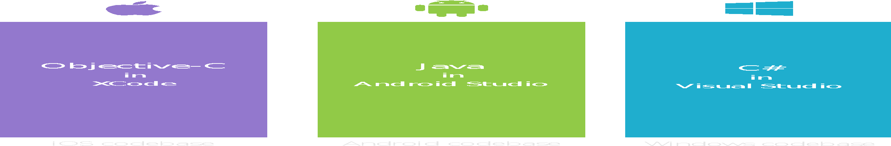
Silo: Build App Multiple Times
Objective-C
in
Xcode
Java
in
Android Studio
C#
in
Visual Studio
No shared code • Many languages & development environments • Multiple teams
Notes:
Speaker Notes:
Explain that this is conventional approach and many of us had been doing this since early days of software engineering.

Slide 3
Silo: Build App Multiple Times
Benefits
Challenges
Full native experience
Total access to the device as provided by SDK
Share Web API
Minimal re-use mostly on back end Web API
Higher development cost from multiple teams (silo teams) or expensive multi-device developers
Multiple codebases to maintain and extend
One platform rules the others are subservient

Slide 4
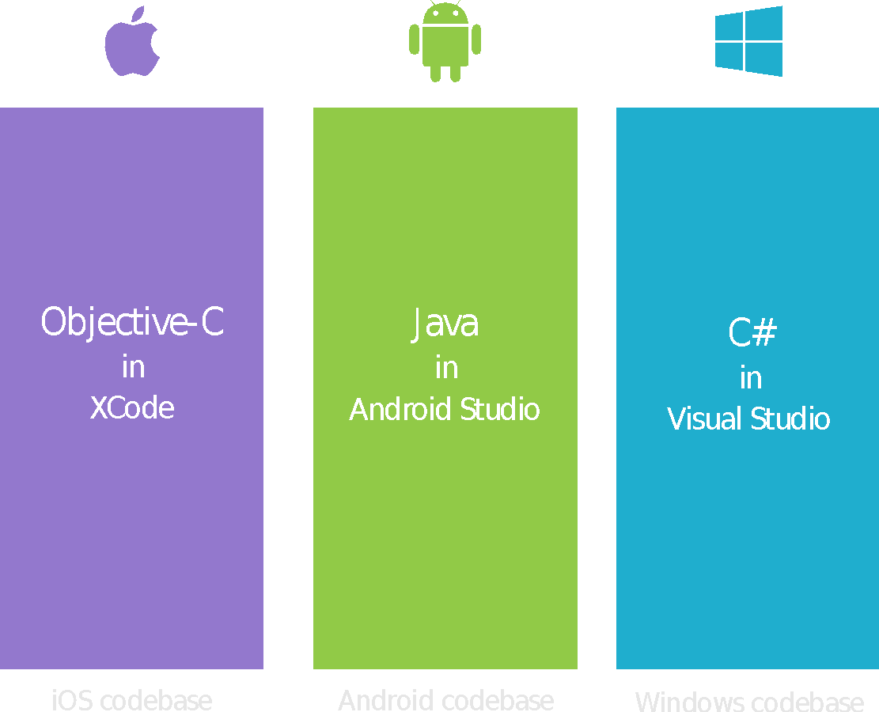



HTML: Write Once, Run Everywhere
Lua
Javascript
Actionscript
HTML+CSS
App Generator
Limited native API access • Slow performance • Poor user experience

Slide 5
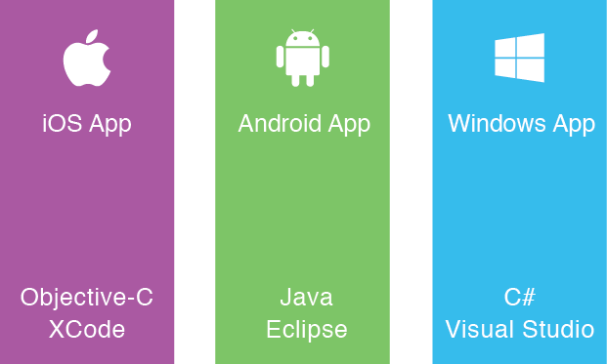
Target Browser Not OS
Web Site

Slide 6
HTML: Write App using Mobile Web
Benefits
Challenges
Provide consist experience regardless of target
Cheap as it is just HTML
Single codebase to maintain and extend
No need for revenue sharing as no need to be in app stores
User experience tends to be webish and not native
Need to still test and debug multiple targets
Features tend to be a subset common to all targets

Slide 7
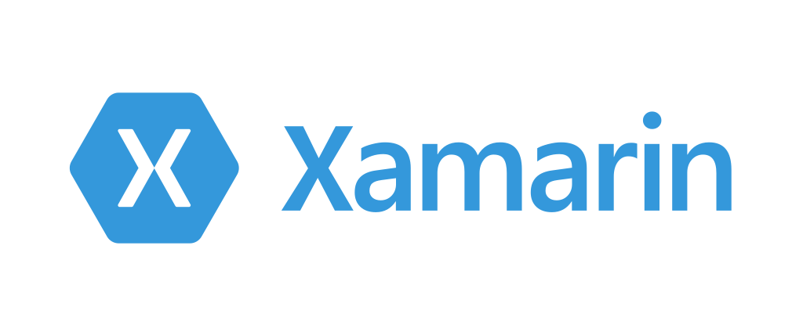
Microsoft
Cross-Platform

Slide 8
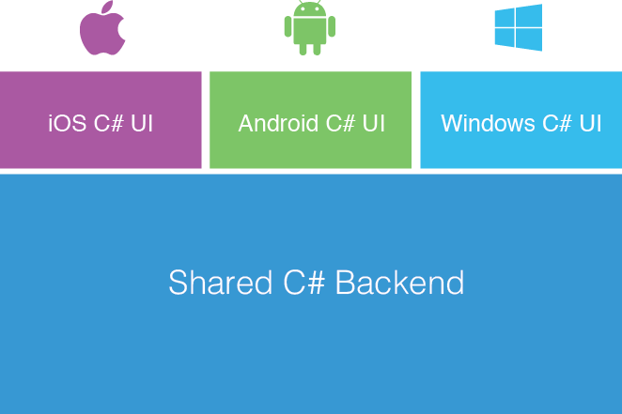
Xamarin Approach

Slide 9
Xamarin Forms Approach
Shared UI Code

Slide 10
Shared vs PCL (Portable Class Library)
Shared
PCL (Portable Class Library)
A Shared Project is not directly compiled (.dll is not generated), instead files are compiled into .dll of project that references it
Can write platform specific code in a same file using compiler directives #ifdef
Cluttered implementation for large projects
Cannot be used other than Xamarin projects
PCL projects are compiled in portable assemblies that run in any .NET based runtime.
Platform specific code cannot be implemented inside a PCL project
Better manageability of code
Better usability and compatibility across other .NET platforms

Slide 11
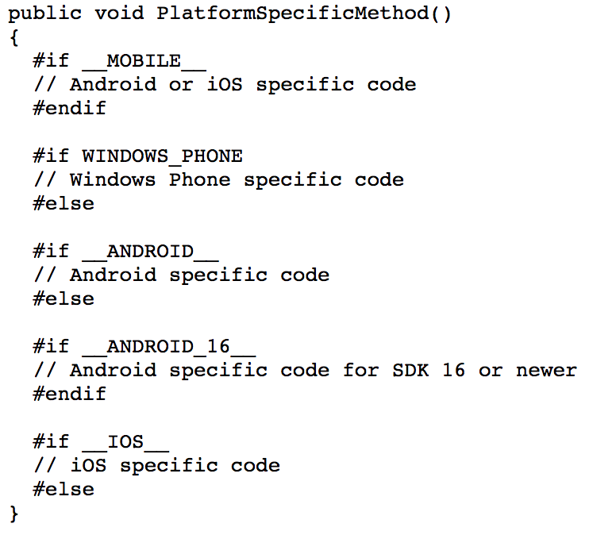
Shared code implementation

Slide 12
Shared vs PCL (Portable Class Library)
Which suits better?
Shared code restricted into compiling directives is more difficult to read, slowing down the development process.
PCL code is much cleaner and maintanable but that is subjective to your development practices (you may end up writing too much boiler plate code)
If you are starting with Xamarin PCL is a better choice for better usability and compatibility across other .NET platforms

Slide 13
Xamarin + Xamarin.Forms Approach
Quickly and easily build native user interfaces using shared code
Xamarin.Forms elements map to native controls and behaviors
Mix-and-match Xamarin.Forms with native APIs
Shared UI Code

Slide 14
How Xamarin Works

Slide 15
Windows APIs
Microsoft.Phone
Microsoft.Networking
Windows.Storage
Windows.Foundation
Microsoft.Devices
System.Net
System
System.IO
System.Linq
System.Xml
System.Data
System.Windows
System.Numerics
System.Core
System.ServiceModel
Notes:
If you have ever developed for a Windows Platform before these .NET namespaces might look familiar.
However, if we go to a new platform such as Windows Phone or Store we have a new SDK to use and a new set of namespaces.

Slide 16
iOS – 100% API Coverage
MapKit
UIKit
iBeacon
CoreGraphics
CoreMotion
System.Net
System
System.IO
System.Linq
System.Xml
System.Data
System.Windows
System.Numerics
System.Core
System.ServiceModel
Notes:
You can think of iOS and Android development the same with Xamarin. You can see we have all of our .NET namespaces and libraries, but Xamarin give us 100% api coverage of each iOS API in it’s SDK that we access view C#.

Slide 17
Android – 100% API Coverage
Text-to-speech
ActionBar
Printing Framework
Renderscript
NFC
System.Net
System
System.IO
System.Linq
System.Xml
System.Data
System.Windows
System.Numerics
System.Core
System.ServiceModel
Notes:
The same is true for Android as well.

Slide 18
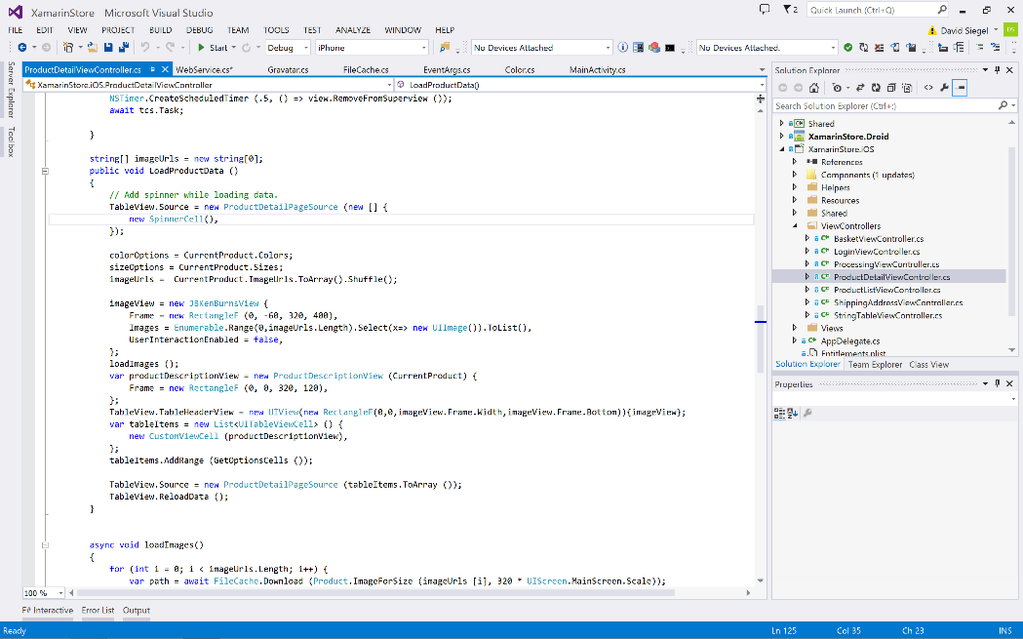
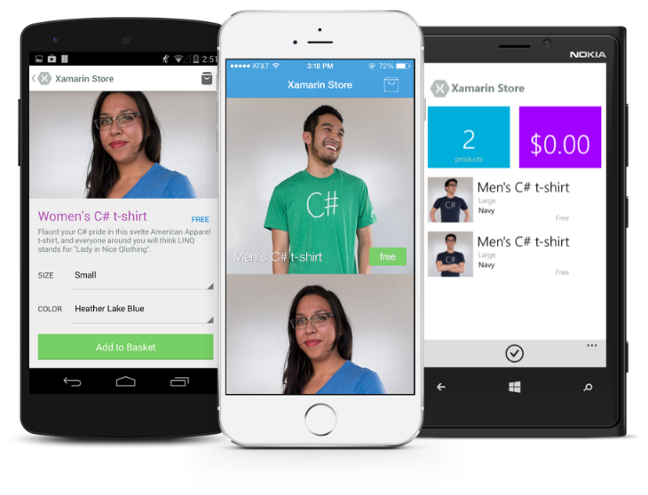
Anything you can do in Objective-C, Swift, or Java can be done in C# and Visual Studio with Xamarin.

Slide 19
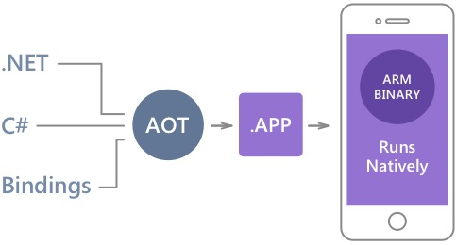
Native Performance
Xamarin.iOS does full Ahead Of Time (AOT) compilation to produce an ARM binary for Apple’s App Store.
Xamarin.Android takes advantage of Just In Time (JIT) compilation on the Android device.
Notes:
There is no compromise on performance.
Xamarin apps look and feel native because they are native.

Slide 20
MVVM
Design Pattern
Notes:
It help to design application.

Slide 21
Relation of MVVM
Model-View-ViewModel
Model
(domain objects)
View
(input, output)
Data Binding
Command
ViewModel
(Business Logic)
Notes:
21
Explain aobut how it works

Slide 22
MODEL
It take care about data or classes that is related to you db or entities in your application.
Notes:
It help to design application.

Slide 23
VIEW
It take care about user interface which is visible to user.
Created with the help of xaml.
Notes:
It help to design application.

Slide 24
VIEWMODEL
It contains all the data that needs to be displayed, binding property and business logic
Notes:
It help to design application.

Slide 25
Benefits of MVVM
Separation of concern.
Increased UI Reusability.
Automated UI or Unit testing.
Easy to debug.

Slide 26
TIME TO HOL
Notes:
It help to design application.

Slide 27





THANK YOU
Abhishek kumar
@abhishabd1
@abhishabd1
@ abhishabd1
@abhishabd1

